Slide 1
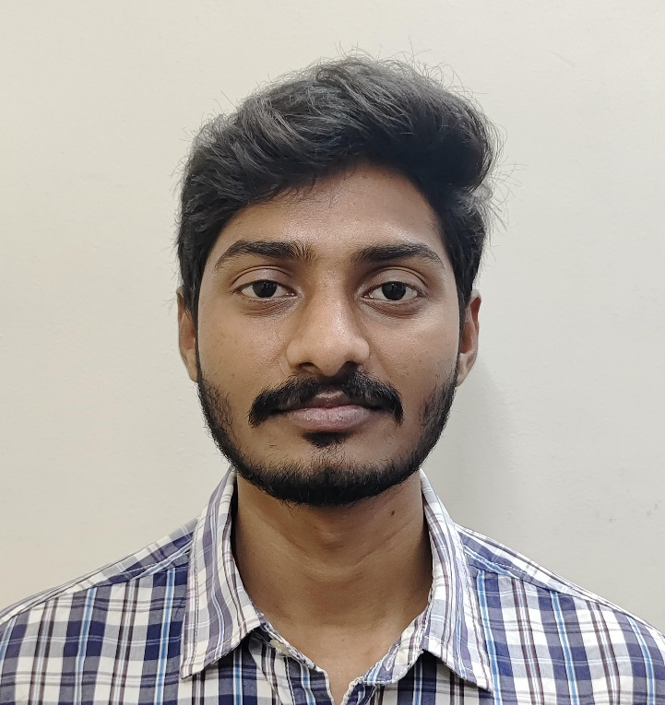
Name: Vinay Kumar Busala
UST Role: Junior SRE
Location: Hyderabad
Family: Father and sister
Total Work Experience: No Experience
College Project: Disease Prediction Audio Chat-Bot (Questionnaire Based)
Technology courses attended: Linux
Professional Certificates : AWS Certified Cloud Practitioner
Professional skill set: Git, Jenkins, Ansible, Kubernetes, AWS, Docker, python, terraform, cloud formation
Hobbies: Playing badminton, Art, Fitness
Interest: Travelling, Photography, Listening to Music

